Slide 1
IO STREAMS & SERIALIZATION

Slide 2

Learning Objectives Exception
File
Input Stream
Output Stream
Reader
Writer
Serialization
Deserialization

Slide 3
File
Java File class represents the files and directory pathnames in an abstract manner. This class is used for creation of files and directories, file searching, file deletion, etc.
Constructor to Create File
File(String pathname)
Methods
public String getPath()
public long length()
public boolean delete()
public long lastModified()

Slide 4
Input and Output Stream
A stream can be defined as a sequence of data.
There are two kinds of Streams
InputStream − The InputStream is used to read data from a source.
OutputStream − The OutputStream is used for writing data to a destination.
Java byte streams are used to perform input and output of 8-bit bytes. Though there are many classes related to byte streams but the most frequently used classes are, FileInputStream and FileOutputStream.
They are used to read/write any stream it could be videos, data and character stream.

Slide 5
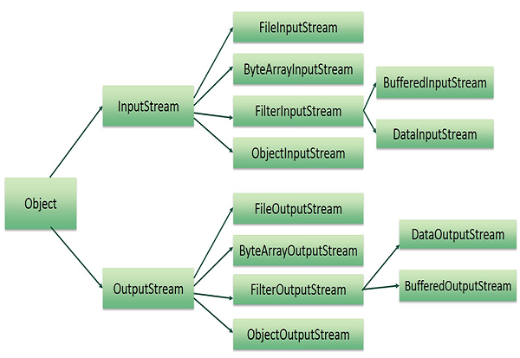
Input and Output Stream Contd.

Slide 6
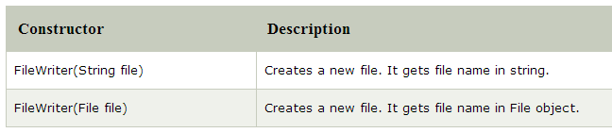
Reader and Writer
Java readers and writers are character-based streams. A reader is used when we want to read character-based data from a data source. A writer is used when we want to write character-based data.
Java FileWriter Class
Java FileWriter class is used to write character-oriented data to a file. It is character-oriented class which is used for file handling in java.

Slide 7
File writer methods
Methods
Void write(String text) -- It is used to write the string into FileWriter.
Void write(char c) -- It is used to write the char into FileWriter.
void write(char[] c) -- It is used to write char array into FileWriter.
void close() -- It is used to close the FileWriter.

Slide 8
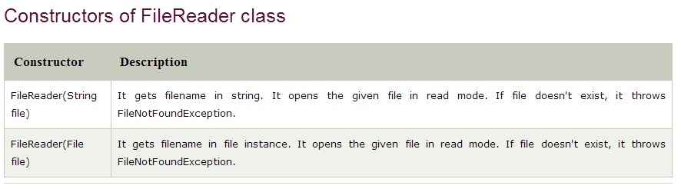
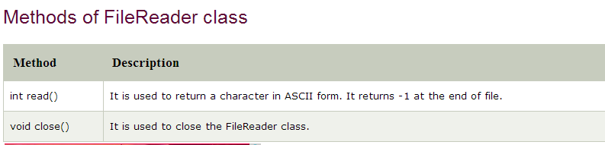
File Reader
Java FileReader class is used to read data from the file. It returns data in byte format like FileInputStream class. It is character-oriented class which Is used for file handling in java.

Slide 9
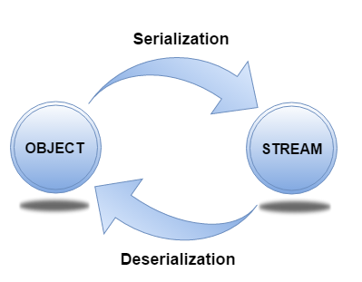
Serialization & Deserialization
Serialization in java is a mechanism of writing the state of an object into a bytestream.The reverse operation of serialization is called deserialization.
It is mainly used in Hibernate, RMI, JPA, EJB and JMS technologies.

Slide 10
Serialization & Deserialization
Serialization
Serializable is a marker interface (has no data member and method). It is used to "mark" java classes so that objects of these classes may get certain capability.
The ObjectOutputStream/ObjectInputStream class is used to write primitive data types and Java objects to an OutputStream. Only objects that support the java.io.Serializable interface can be written to streams.
Deserialization
Deserialization is the process of reconstructing the object from the serialized state. It is the reverse operation of serialization.

Slide 11
What are we learning in Next Chapter ?
COLLECTIONS & GENERICS
Collection Interface
List
Set
Map
Collection implementation classes
Collections CLASS

Slide 12
Thank You !

